Slide 1
F-750 Model Fit Parameter
- Background – Calculation - Applications

Slide 2
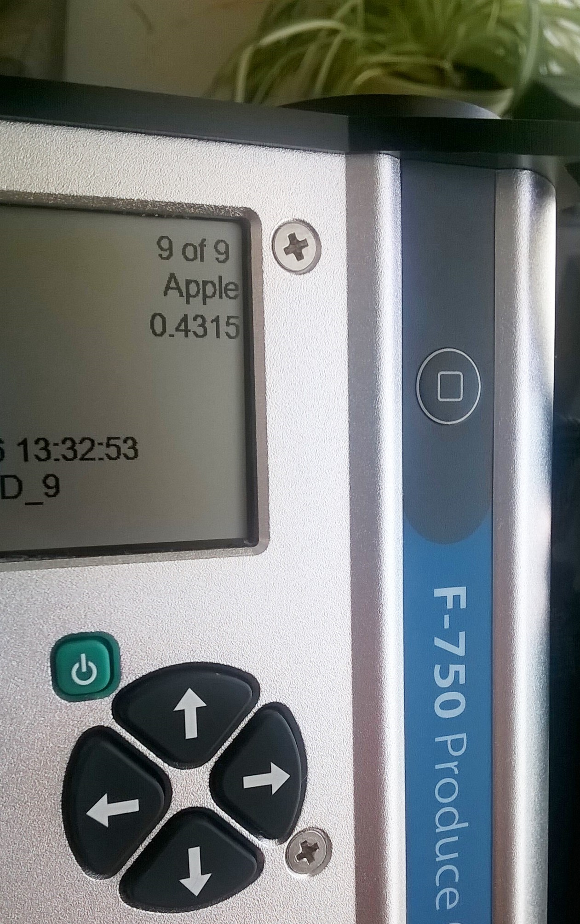
Background: What is it?
A description of the fit of a sample versus one or more training sets
Calculated by multiplication of deviation from the normal range by the wavelength influence
Deviation: A metric calculated internally by the F-750. This number determines whether or not the signal at a given wavelength falls within the training set data
Wavelength Influence: Determined by the range of spectra and the goodness of fit in the training set weighted against the rest of the spectra.
Visualized in Model Builder under the “Model Performance Analysis” tab

Slide 3
Background: Training Set Bounds
Parameter to test fit of a sample against training sets
When training sets are acquired, F-750 records the highest and lowest observed value at a particular wavelength

Slide 4
Background: Wavelength Influence
Derivation (at each wavelength):
How well do spectra match (heat map/rainbow)
How large is the difference?
How large is this number compared with the rest of the spectra (% weighting)
1
2
3

Slide 5
Calculation
At each wavelength bin:
IF the sample is outside the training set range,
Add the product of the deviation times the wavelength influence coefficient to the Model Fit parameter
OTHERWISE,
Add zero to the Model Fit parameter
$$\sum_{285}^{1200}{(Abs\left(deviation\right)∗(λ Influence})$$
Model Fit =

Slide 6
Good Model Fit
Poor Model Fit
Sum: LOW (closer to 0)
Sum: HIGH (closer to 1)

Slide 7
Applications
Determine suitability of training set
If a test sample yields a high model fit number (closer to 1), the training set is insufficient to predict the sample
If a test sample yields a very low model fit number (closer to 0), this indicates that the sample has similar spectral characteristics to the training set.
The sample will be predicted with an accuracy determined by the robustness of the model using that particular training set
Contact support with any questions or comments at support@felixinstruments.com

